Slide 1
IDENTIFICATION OF ARRHYTHMIA USING ELECTROCARDIOGRAM DATA
Presented to
Dr. Harnath Kar
DEPARTMENT OF ELECTRONICS AND COMMUNICATION ENGINEERING
MOTILAL NEHRU NATIONAL INSTITUTE OF TECHNOLOGY
ALLAHABAD-211004 , INDIA
AMAN AGRAWAL -20155056
DEEPANJAN SAHA-20152048
PAWAN KUMAR THAPA-20155032

Slide 2
CONTENT
INTRODUCTION
MOTIVATION
OBJECTIVE
WORKFLOW

Slide 3
INTRODUCTION
What is Arrhythmia ?
Heart arrhythmia, also known as irregular heartbeat or cardiac dysrhythmia, is a group of conditions where the heartbeat is irregular, too slow, or too fast
Types of Arrhythmia
Slow heartbeat: bradycardia.
Fast heartbeat: tachycardia.
Irregular heartbeat: flutter or fibrillation.
Early heartbeat: premature contraction
Causes of Arrhythmia
Any interruption to the electrical impulses that cause the heart to contract can result in arrhythmia
Some common causes are
alcohol abuse
diabetes
drug abuse
excessive coffee consumption
smoking

Slide 4
OUR MOTIVATION
More than 10 million cases of arrhythmia are reported in India every year. If arrhythmia prevail in patient for a long time then it can cause severe damage to heart resulting in:
Stroke - fibrillation (quivering) means that the heart is not pumping properly. This can cause blood to collect in pools and clots can form. If one of the clots dislodges it may travel to a brain artery, blocking it, and causing a stroke. Stroke can cause brain damage and can sometimes be fatal.
Heart failure - prolonged tachycardia or bradycardia can result in the heart not pumping enough blood to the body and its organs - this is heart failure. Treatment can usually help improve this
Since it is a widespread disease if diagnosed at an early stage could save many lives.

Slide 5
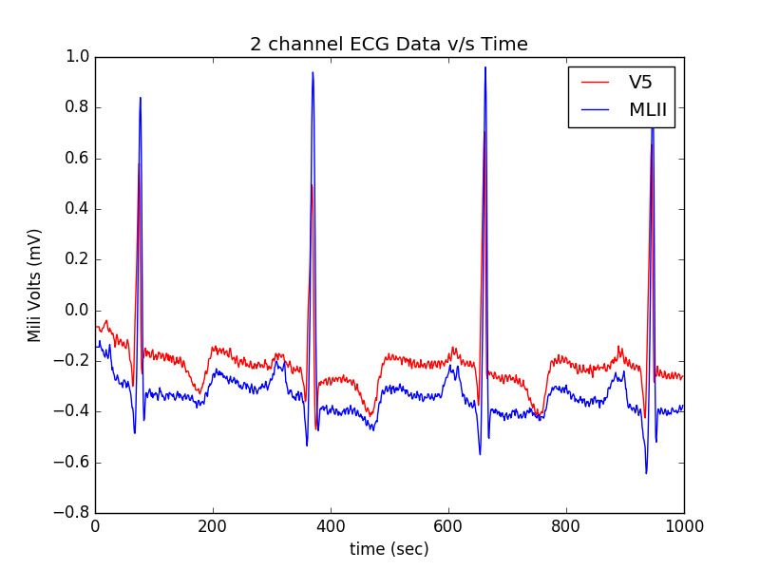
ABOUT THE DATASET
The MIT-BIH Arrhythmia Database contains 48 half-hour excerpts of two-channel ambulatory ECG recordings, obtained from 47 subjects studied by the BIH Arrhythmia Laboratory between 1975 and 1979.
The recordings were digitized at 360 samples per second per channel with 11-bit resolution over a 10 mV range.
Each ECG record consist of 2 channels i.e, Modified Lead Limb II and V5 lead.

Slide 6
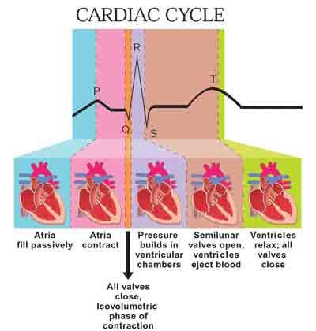

Slide 7
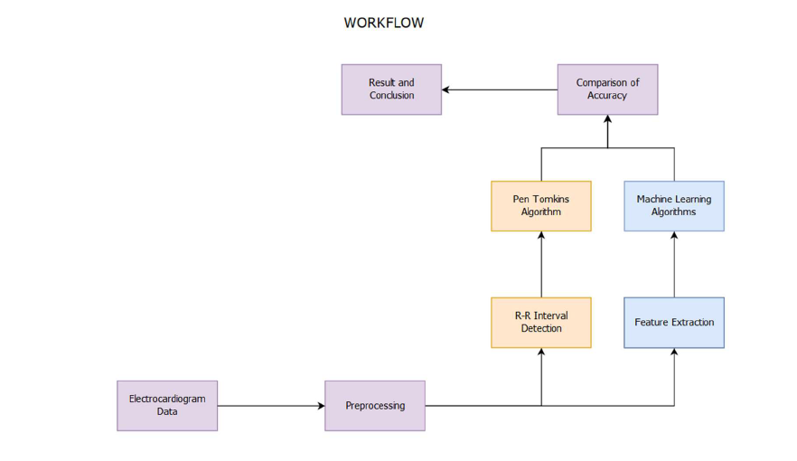
WORKFLOW

Slide 8
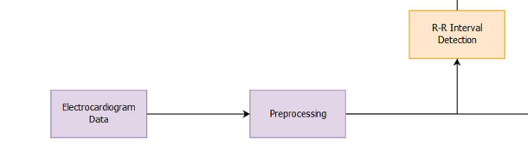
WORK DONE SO FAR
Preprocessing step includes passing the V5 channel signal through bandpass filter, then preivetive, then through squaring, then thresholding , then moving average, and again through thresholding.
R-R interval detection block involves edge detection, then finding the time stamp of the rising edge and storing the difference between 2 time stamp.

Slide 9
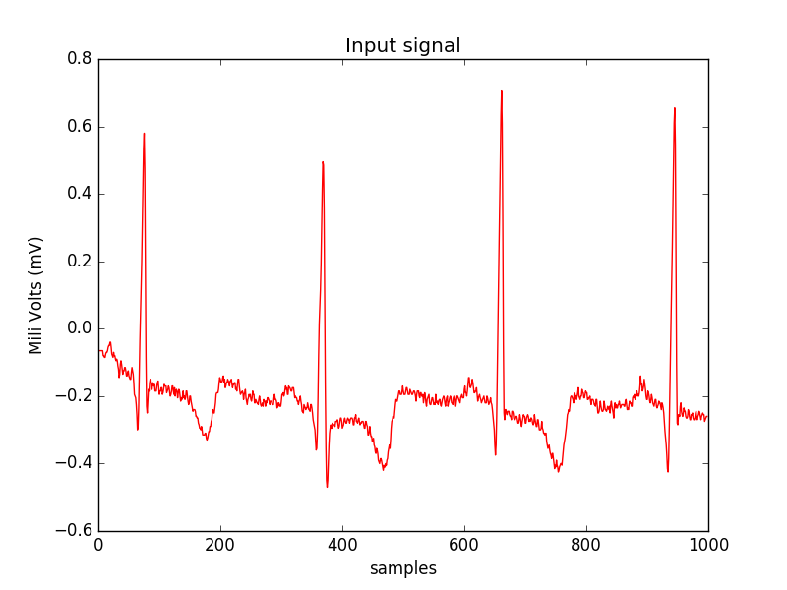
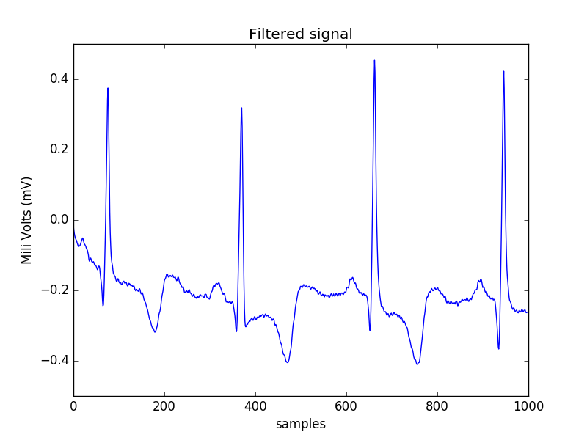
SAMPLE OUTPUT

Slide 10
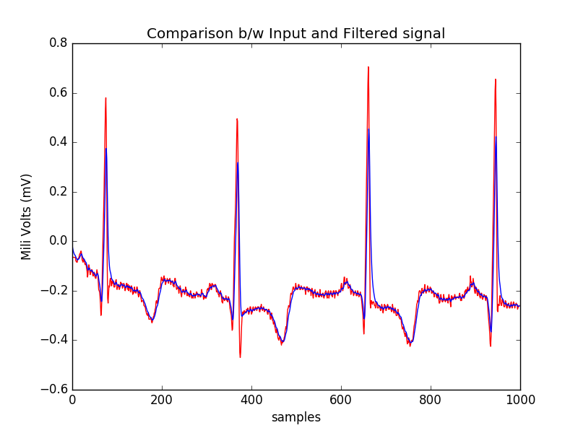
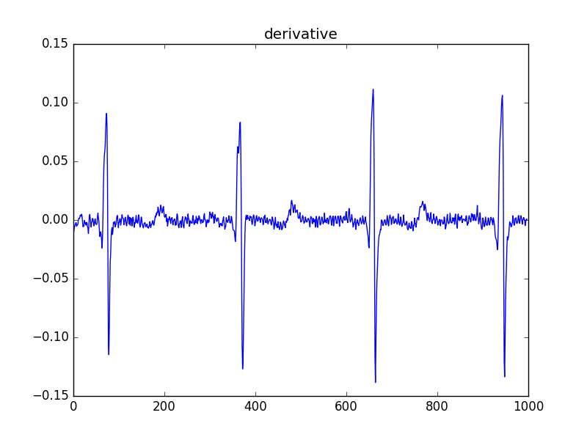
SAMPLE OUTPUT

Slide 11
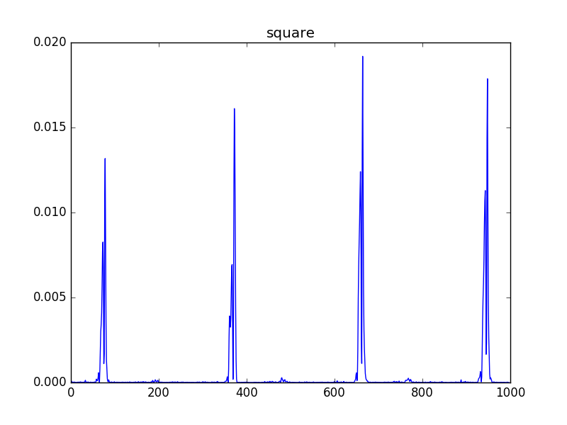
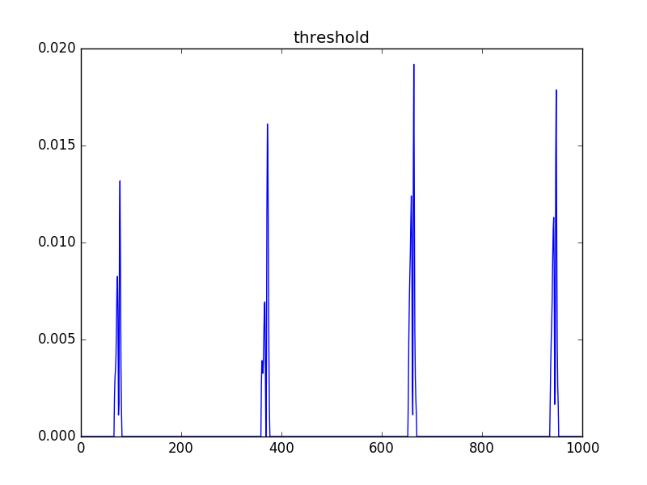
SAMPLE OUTPUT

Slide 12
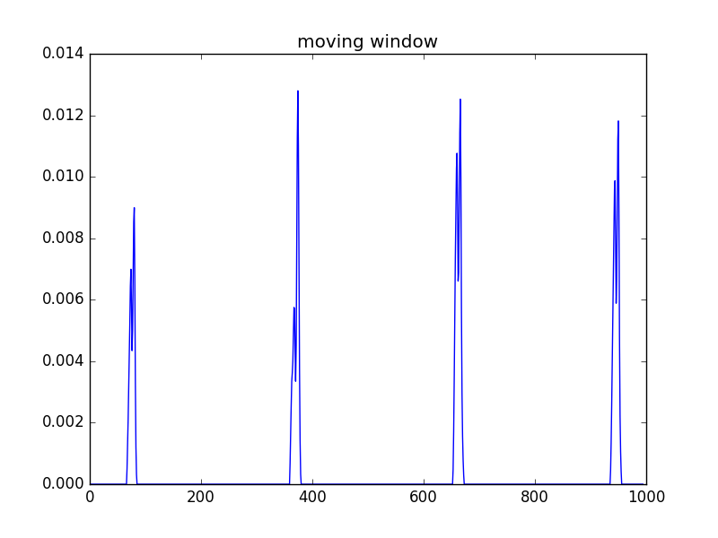
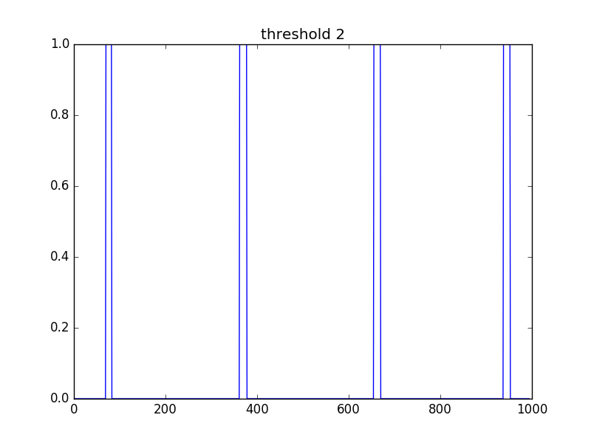
SAMPLE OUTPUT

Slide 13
TOOLS / RESOURCES
Langueage Used: Python3
Libraries Used: Scikit-Learn, Matplotlib, Numpy, Scipy, Tensorflow
Database Used: MIT-BIH Arrhythmia Database developed by MIT in collaboration with Boston’s Beth Israel Hospital (BIH)

Slide 14
REFERENCES
J. Pan and W. J. Tompkins, “A real-time QRS detection algorithm.” IEEE Trans on biomedical engineering, vol. 32, no. 3, pp. 230–6, Mar. 1985.
Arrhythmia: Causes, symptoms, types and treatment written by Christian Nordqvist (https://www.medicalnewstoday.com/articles/8887.php)
,MG. Tsipouras, DI Fortiadis and D Sideris, “Arythmia Classification using the R-R interval Duration Signal.”

Slide 15
THANK YOU

